Slide 1

The Health Insurance Marketplace 101
The Affordable Care Act: What’s Happened So Far, What’s Happening, and What’s Coming Next
August 7, 2013
Notes:
The Health Insurance Marketplace 101 provides a high-level overview of the Affordable Care Act, and the new Health Insurance Marketplace.
The Centers for Medicare & Medicaid Services (CMS) developed and approved this training module. CMS is the federal agency that administers Medicare, Medicaid, the Children’s Health Insurance Program (CHIP), and the Health Insurance Marketplace. Information in this module was correct as of May 2013.
To check for an updated version of this training module, visit http://www.cms.gov/Outreach-and-Education/Training/CMSNationalTrainingProgram/index.html
To check for updates on the new health care legislation, visit www.healthcare.gov
To view the Affordable Care Act, visit www.healthcare.gov/law/full/index.html
This set of CMS National Training Program materials isn’t a legal document. Official Medicare program provisions are contained in the relevant statutes, regulations, and rulings.

Slide 2
Office of the Regional Director
Community Resource
    California-Based, extensive travel to AZ, NV, HI, and significant work with the Pacific
    Day-to-day, week-to-week, month-to-month
    Educate the public on the benefits of healthcare reform
      -- Healthcare.gov
      -- CuidadodeSalud.gov (Spanish)
      -- Information in Other Languages

Slide 3
National Health Reform – A Reality
In March 2010, President Obama signed into law the
Affordable Care Act.

Slide 4
Framework of Health Reform
Importance of Federal AND Tribal AND State AND Local Involvement in ACA Implementation

Slide 5
Framework of Health Care Reform
  Expanding Access and Coverage
  Consumer Protections
  Improving Quality and Lowering Costs

Slide 6
Individual Requirement
January 1, 2014
Exemptions include:
  Financial hardship;
  Religious objections;
  Native Americans
  Without coverage for less than 3 months;
  Incarcerated individuals; and
  Cost exceeds 8% of individual’s income.

Slide 7
Employer Requirement
(Shared Responsibility)
  -- Less than 50 full-time equivalents – exempt from any requirement.

Slide 8
Affordable Care Act –
Accomplishments-Quality and Cost
Slowest sustained national health spending growth in 50 years
  Low growth continuing in 2012 for Medicare and Medicaid
$1.6 billion returned to consumers in 2011 and 2012
  Plans must spend 80% now on healthcare
Rate increases fell from 75% in 2010 to 14% so far in 2013
$4.2 billion recovered in 2012 from anti-fraud efforts – a record high – for a total of nearly $15 billion over the last 4 years, double that of the previous 4 years
Notes:
This is a highlight of some of the cost savings accomplished by the Affordable Care Act:
Slowest sustained national health spending growth in 50 years, with low growth continuing in 2012 for Medicare and Medicaid
$2.1 billion has been returned to consumers through medical loss ratio (80 / 20 rule) rebates and rate review in 2011
Percent of double-digit rate increases fell from 75% in 2010 to 14% so far in 2013
$4.2 billion was recovered in 2012 from anti-fraud efforts – a record high – for a total of nearly $15 billion over the last 4 years, double that of the previous 4 years

Slide 9
Affordable Care Act –
Coverage Accomplishments in Arizona
69,000 young adults have gained insurance through their parents’ plans
In 2012 alone, 65,267 people with Medicare received over $45 million in prescription drug discounts
434,397 people with Medicare received a free preventive service in 2012
1.4 million privately insured people gained improved coverage for preventive services
2 million Arizona residents have had lifetime limits removed from their insurance

Slide 10
Arizona’s Medicaid/AHCCCS Expansion
Arizona has expanded AHCCCS eligibility to adults ages 19 – 64 with incomes up to 138% of the Federal Poverty Level ($15,856 per year for an individual).
  100% federal funding for newly Medicaid eligible
Shifts to simplified way of calculating income to determine AHCCCS/CHIP eligibility
  Known as Modified Adjusted Gross Income (MAGI)
Notes:
States have the option to expand Medicaid eligibility to adults ages 19 – 64 with incomes up to 133% of the Federal Poverty Level (FPL) ($15,282/year for an individual, $31,322/year for a family of 4)
100% federal funding for newly Medicaid eligible
States have no deadline to decide if they are going to expand
One streamlined application for Medicaid or private health plans
Shifts to simplified way of calculating income to determine Medicaid/CHIP eligibility
Known as Modified Adjusted Gross Income (MAGI)

Slide 11
Medicaid/AHCCCS Reimbursements
Increases Medicaid payment rates for primary care to 100% of Medicare rates in 2013 and 2014.
The federal government will pay 100% of the cost of covering newly-eligible individuals for the first three years of expansion.
Notes:
States have the option to expand Medicaid eligibility to adults ages 19 – 64 with incomes up to 133% of the Federal Poverty Level (FPL) ($15,282/year for an individual, $31,322/year for a family of 4)
100% federal funding for newly Medicaid eligible
States have no deadline to decide if they are going to expand
One streamlined application for Medicaid or private health plans
Shifts to simplified way of calculating income to determine Medicaid/CHIP eligibility
Known as Modified Adjusted Gross Income (MAGI)

Slide 12
Introduction to the Marketplace
The Marketplace/Exchange, Federally-Facilitated
  Place for individuals and small employers to directly compare private health insurance options
    Known as Qualified Health Plans (QHPs)
  Can directly compare on the basis of price, benefits, quality, and other factors
Notes:
The Marketplace (or Exchange)
Place for individuals and small employers to directly compare private health insurance options known as Qualified Health Plans (QHPs)
Can directly compare on the basis of price, benefits, quality, and other factors

Slide 13
3 Things to Know about the Marketplace…
1. It’s an easier way to shop for health insurance
  Simplifies the search for health insurance
  All options in one place
  One application, one time, and an individual or family can explore every qualified insurance plan in the area
2. Most people will be able to get a break on costs
  90% of people who are currently uninsured will qualify for discounted or free health insurance
3. Clear options with apples-to-apples comparisons
  All health insurance plans in the Marketplace present their price and benefit information in plain language
Notes:
1. It’s an easier way to shop for health insurance
Simplifies the search for health insurance
All options in one place
One application, one time, and an individual or family can explore every qualified insurance plan in the area
2. Most people will be able to get a break on costs
90% of people who are currently uninsured will qualify for discounted or free health insurance
3. Clear options with apples-to-apples comparisons
All health insurance plans in the Marketplace present their price and benefit information in simple terms you can understand

Slide 14
Assistance to Arizona Consumers and Small Businesses
Navigator Awards -- Mid-August
2. Marketplace Call Center (Consumers) - 24/7 – English and Spanish and 150 Languages
    1-800-318-2596, 1-855-889-4325 (TTY)
3. SHOP Marketplace for Businesses - 1-800-706-7893
  https://www.healthcare.gov/what-is-the-shop-marketplace/
Certified Application Counselor
  http://www.cms.gov/CCIIO/Programs-and-Initiatives/Health-Insurance-Marketplaces/assistance.html
Agent and Broker Training
  http://www.cms.gov/CCIIO/programs-and-initiatives/health-insurance-marketplaces/a-b-resources.html
Champions for Coverage
  http://marketplace.cms.gov/help-us/champion.html
Notes:
1. It’s an easier way to shop for health insurance
Simplifies the search for health insurance
All options in one place
One application, one time, and an individual or family can explore every qualified insurance plan in the area
2. Most people will be able to get a break on costs
90% of people who are currently uninsured will qualify for discounted or free health insurance
3. Clear options with apples-to-apples comparisons
All health insurance plans in the Marketplace present their price and benefit information in simple terms you can understand

Slide 15
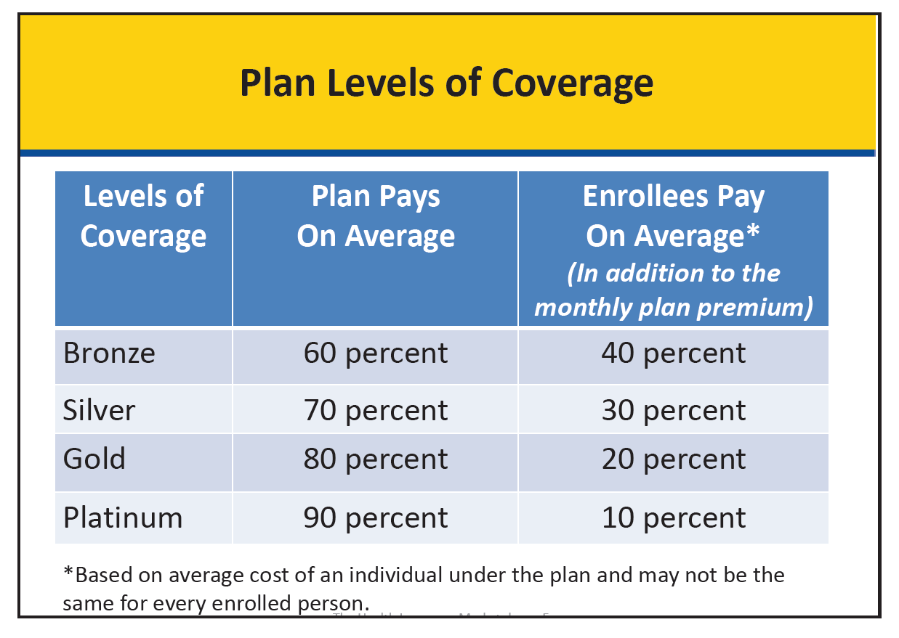

Slide 16

The Marketplace
  A new way to get health insurance
    Enrollment starts October 1, 2013
    Coverage begins January 2014
About 25 million Americans will have access to quality health insurance
  Up to 20 million may qualify for help to make it more affordable
  Working families can get help through the Marketplace
Notes:
The Marketplace is for individuals and small employers to directly compare certain competitive private health insurance options, known as Qualified Health Plans, on the basis of price, quality, and other factors. This presentation only focuses on coverage for individuals and not on small businesses.
The Marketplace, which will become fully operational by January 1, 2014, will help enhance competition in the health insurance market, improve choice of affordable health insurance, and give small businesses similar options as large businesses.
When key parts of the health care law take effect, there’ll be a new way to buy health insurance: the Health Insurance Marketplace.
Enrollment starts October 1, 2013
Coverage begins January 2014

Slide 17
Eligibility and Enrollment
Open enrollment period starts October 1, 2013 and ends March 31, 2014
Eligibility requires consumers to
  Live in its service area, and
  Be a U.S. citizen or national, or
  Be a non-citizen who is lawfully present in the U.S. for the entire period for which enrollment is sought
  Not be incarcerated
Notes:
Marketplace initial open enrollment period starts October 1, 2013 and ends March 31, 2014
Marketplace eligibility requires consumers to
Live in its service area, and
Be a U.S. citizen or national, or
Be a non-citizen who is lawfully present in the U.S. for the entire period for which enrollment is sought
Not be incarcerated

Slide 18
Advantages of the Marketplace
Helps enhance competition in the health insurance market
Increases Affordability through premium tax credits, cost sharing reductions, or public insurance programs
Ensures Quality through QHPs that must meet basic standards, including quality standards, consumer protections, and access to an adequate range of clinicians
Makes Costs Clear by providing information about prices and benefits in simple terms consumers can understand, so they don’t have to guess about costs
Notes:
Helps enhance competition in the health insurance market
Increases Affordability through premium tax credits, cost sharing reductions, or public insurance programs
Ensures Quality though QHPs that must meet basic standards, including quality standards, consumer protections, and access to an adequate range of clinicians
Makes Costs Clear by providing information about prices and benefits in simple terms consumers can understand, so they don’t have to guess about costs

Slide 19
All Qualified Health Plans Will Cover These Essential Health Benefits
Ambulatory patient services
Emergency services
Hospitalization
Maternity and newborn care
Mental health and substance use disorder services, including behavioral health treatment
Prescription drugs
Rehabilitative and habilitative services and devices
Laboratory services
Preventive and wellness services and chronic disease management
Pediatric services, including oral and vision care
Notes:
The Health Care Law provides for the establishment of an Essential Health Benefit (EHB) package that includes coverage of EHBs (as defined by the Secretary of the Department of Health and Human Services (the Secretary)). The law directs that EHBs be equal in scope to the benefits covered by a typical employer plan and cover at least the following 10 general categories:
Ambulatory patient services
Emergency services
Hospitalization
Maternity and newborn care
Mental health and substance use disorder services, including behavioral health treatment
Prescription drugs
Rehabilitative and habilitative services and devices
Laboratory services
Preventive and wellness services and chronic disease management
Pediatric services, including oral and vision care

Slide 20
Catastrophic Plans
Who is eligible?
  Young adults under 30 years of age
  Those who can not afford coverage and obtain a hardship waiver
What is catastrophic coverage?
  Plans with high-deductibles and lower premiums
  Includes coverage of 3 primary care visits and preventive services with no out-of-pocket costs
  Protects consumers from high out-of-pocket costs
Notes:
Who is eligible
Young adults under 30 years of age
Those who can not afford coverage and obtain a hardship waiver from the Marketplace
What is catastrophic coverage?
Plans with high-deductibles and lower premiums
Includes coverage of 3 primary care visits and preventive services with no out-of-pocket costs
Protects consumers from high out-of-pocket costs

Slide 21

Help to Pay Qualified Health Plan Costs
Based on family income and size
  Premium discount
    Family of four with annual income $23,550* – $94,200* or less
    And not eligible for certain other insurance coverage like Medicaid
  Lower cost-sharing (like copays)
    Family of 4 with annual income $58,875* or less (some other restrictions)
*2013 amounts
Notes:
The new premium discount available through the Marketplace lets you reduce your costs right away. People who qualify can take the premium discount in the form of advance payments to lower their monthly Marketplace health plan premiums starting in 2014, which can help make insurance more affordable. A payment will go directly to the insurance company. When you apply, you will provide your household income, identification to show that you are in the U.S. legally and other information. The premium discount is generally available to individuals and families with incomes between 100% and 400% of the Federal Poverty Level ($23,550 – $94,200 for a family of four in 2013) who do not have access to certain other types of minimum essential coverage, which will make coverage much more affordable for the middle class. The Congressional Budget Office estimates that when the Affordable Care Act is fully phased in, the premium tax credit will help 20 million Americans afford health insurance.
To be eligible for cost-sharing reductions, you must have a household income that is less than or equal to 250% of the Federal Poverty Level (FPL) which is $58,875 annually for a family of four in 2013; meet the requirements to enroll in a health plan through the Marketplace and receive the premium discount; and enroll in a silver-level plan through the Marketplace.
Certain American Indians and Alaska Natives who purchase health insurance through the Marketplace do not have to pay co-pays or other cost sharing if their income is under 300 percent of the Federal poverty level, which is roughly $70,650 for a family of four in 2013 ($88,320 in Alaska).

Slide 22
The Situation for
Small Employers Today
Many obstacles to offering health insurance to employees
Difficulty comparison shopping between plans
Unpredictable rate increases
Higher rates for groups with:
  o Older workers
  o Workers who have chronic conditions or high‐cost illnesses
Waiting periods for coverage of pre‐existing conditions
Notes:
1. It’s an easier way to shop for health insurance
Simplifies the search for health insurance
All options in one place
One application, one time, and an individual or family can explore every qualified insurance plan in the area
2. Most people will be able to get a break on costs
90% of people who are currently uninsured will qualify for discounted or free health insurance
3. Clear options with apples-to-apples comparisons
All health insurance plans in the Marketplace present their price and benefit information in simple terms you can understand

Slide 23
Removing the Obstacles:
Tax Credits
The Small Business Health Care Tax Credit Is available to those employers :
With fewer than 25 “full‐time equivalent” employees
Whose employees’ wages average less than $50,000 per year
Who contribute at least 50% of employees’ premium costs
Who buy health insurance through the SHOP only, starting in 2014
Is worth:
Up to 35% of employer’s premium contribution (up to 25% for tax‐exempt employers) now
Up to 50% of employer’s premium contribution (up to 35% for tax exempt employers) starting in 2014
Notes:
1. It’s an easier way to shop for health insurance
Simplifies the search for health insurance
All options in one place
One application, one time, and an individual or family can explore every qualified insurance plan in the area
2. Most people will be able to get a break on costs
90% of people who are currently uninsured will qualify for discounted or free health insurance
3. Clear options with apples-to-apples comparisons
All health insurance plans in the Marketplace present their price and benefit information in simple terms you can understand

Slide 24
Enrolling in SHOP:
Who, When & How?
Who’s eligible?
2014 /2015 - Upper limit of 100 FTEs. Some Marketplaces may opt to set the upper limit at 50.
2016 – Marketplaces must accommodate 100 FTE and below.
2017 and Beyond – States can decide their upper limit.
When can businesses enroll?
Starting October 1, 2013, for coverage beginning January 1, 2014 Thereafter, throughout the year
How can businesses enroll?
Directly through the SHOP
Through a broker registered with the SHOP
Notes:
1. It’s an easier way to shop for health insurance
Simplifies the search for health insurance
All options in one place
One application, one time, and an individual or family can explore every qualified insurance plan in the area
2. Most people will be able to get a break on costs
90% of people who are currently uninsured will qualify for discounted or free health insurance
3. Clear options with apples-to-apples comparisons
All health insurance plans in the Marketplace present their price and benefit information in simple terms you can understand

Slide 25
Key Points to Remember
The Marketplace is a new way to find and buy health insurance
Individuals and small businesses can shop for health insurance that fits their budget
States have flexibility to establish their own Marketplace
There is financial help for working families and other people with limited income
There is assistance available to help consumers get the best coverage for their needs
Notes:
The Marketplace is a new way to find and buy health insurance
Individuals and small businesses can shop for health insurance that fits their budget
States have flexibility to establish their own Marketplace
There is financial help for working families and other people with limited income
There is assistance available to help consumers get the best coverage for their needs

Slide 26
Thank you!
Herb K. Schultz
Regional Director, Region IX
U.S. Department of Health & Human Services
90 Seventh Street, Suite 5-100
San Francisco, CA 94103
(415) 437-8500 – Main Number
(415) 437-8502 – Direct Number
(415) 265-7049 – Cell Phone
Herb.Schultz@hhs.gov
HHS Website: www.hhs.gov
Notes:
Need more information about the Health Insurance Marketplace?
Sign up to get email and text alerts at signup.healthcare.gov
Updates and resources for partner organizations are available at Marketplace.cms.gov/
Like us on Facebook and follow us on Twitter!

